Slide 1
Git and using GitHub
Unless you don’t like being able to work with other people and see the changes you made in the past

Slide 2

FIRST THING’S FIRST!
Git ≠ GitHub
Git is Form of Version Control Software
AKA source control
Many other forms
GitHub is a place to host your Git Repositories online
Other websites offer this too like BitBucket

Slide 3

Ways to use Git
There are pretty much two main ways to use Git
Command Lines
Pros: You are really forced to understand Git
Cons: You are really forced to understand Git
GUI Tools (GitHub Desktop, Git Extensions, etc)
Pros: Way easier to use and manage code
Cons: This is how you look to some people

Slide 4
Gotta Get Git
Command Line
https://git-scm.com/downloads
Git Bash is just a Windows side application that opens a command prompt with Git
GitHub Desktop GUI (what I recommend)
https://desktop.github.com/

Slide 5
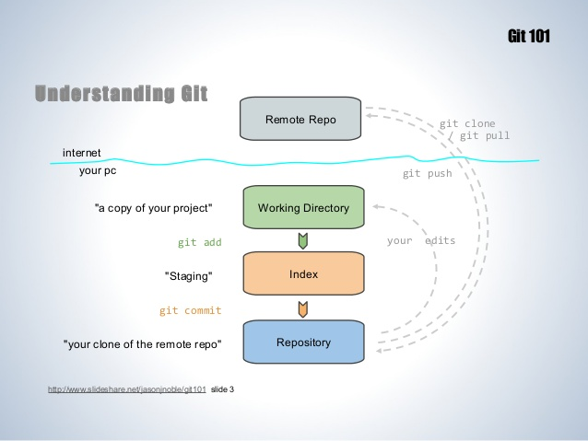
Git 101- What happens to code
Repository (the code) is saved on local computer
Repositories can then be Pushed to a remote server where other people can push too

Slide 6
Git 101 – It Remembers …so you don’t have too
“I’ll just save the code to a flash drive and give it to you”
If you say this again instead of using Git you will wake up as a Political Science Major
Git saves all past Committed saves in a .git file in the repository
New people can go back to ANY old Commit made during life of repository

Slide 7
Git 101 – Workflow
Obtain a repository
If you have the repository already, Fetch the latest version to sync up with it
Make your edits
Stage your changes
Commit your work
Push to remote location so combine
Wait for other people to pull their weight and add code to the repo, then Pull it

Slide 8
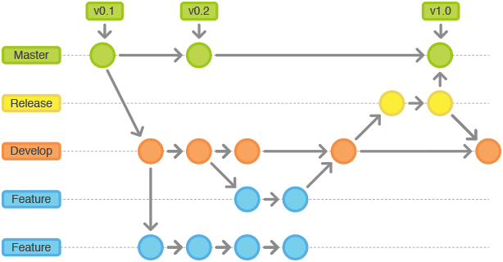
Git 101 - Branches
Branches let you work on the code in your own crazy direction and Merge it back later
Example: Make a “New-Feature” branch and when it is ready, Merge back to the Master Branch

Slide 9
Git 101 – The “Magic Moment”
“Wait, it updated the folder for me!?!?”
You will say this at least once
The “Magical” part of using Git is whenever you Pull from the latest commits, change Branches, or Revert to an old Commit in the Repo the folders on your local machines will reflect the changes
If you had a file called “Hello.c” deleted a few commits ago and you go back the file will be back in your folder on your machine…Magic!

Slide 10
GitHub GUI – Make new repo
Can either create online or bring it to local computer
Start new repository and push to GitHub when ready (If using a private repo, why wait)
HUGE SIDE NOTE: Go here if you haven’t before https://education.github.com/pack/offers and get your free private repositories
Can take a current set of code and make it into a Git repo
Will have no history prior to initialization of git

Slide 11
How to use GUI
If you want to learn more go here: https://guides.github.com/
If you want to get this repo go here
https://github.com/sjfricke/IEEE_RaspberryPi_Socket_Pokemon
Click the “Clone or Download” button and Clone it to your desktop (will open Desktop GUI for you)

Slide 12
GitHub Permissions
For a project you can always just download the code and do what you want.
If you want to make changes, either Clone or Fork the Repository
You can then send a Pull Request that will let someone in charge of Repo check your changes and Merge it
If you set someone as a Collaborator they can Push code without having to submit a Pull Request

Slide 13
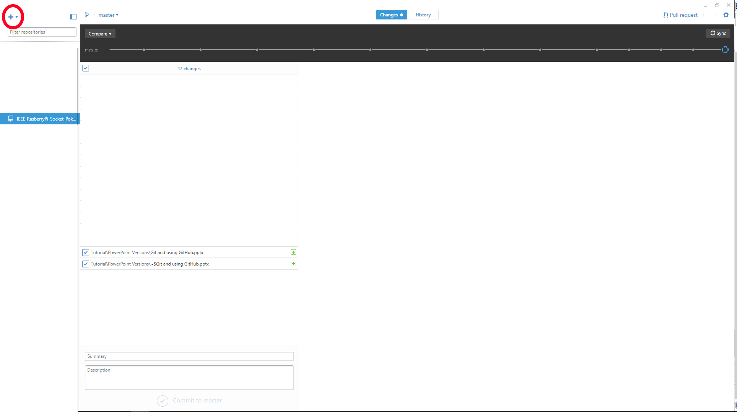
Click here to add the Repo

Slide 14
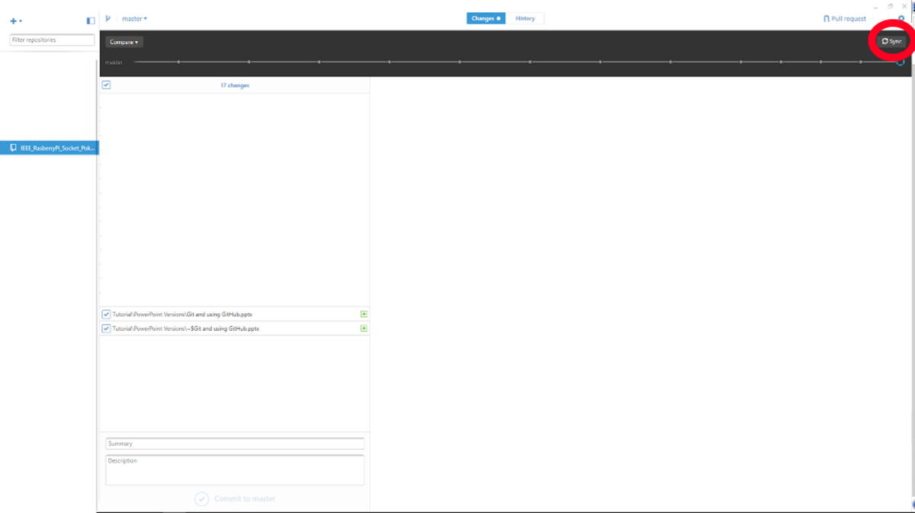
Click here to sync with Repo
Use to get the latest version (ALWAYS Do this before you start!)
If you are a Collaborator you can use this to push to Server

Slide 15
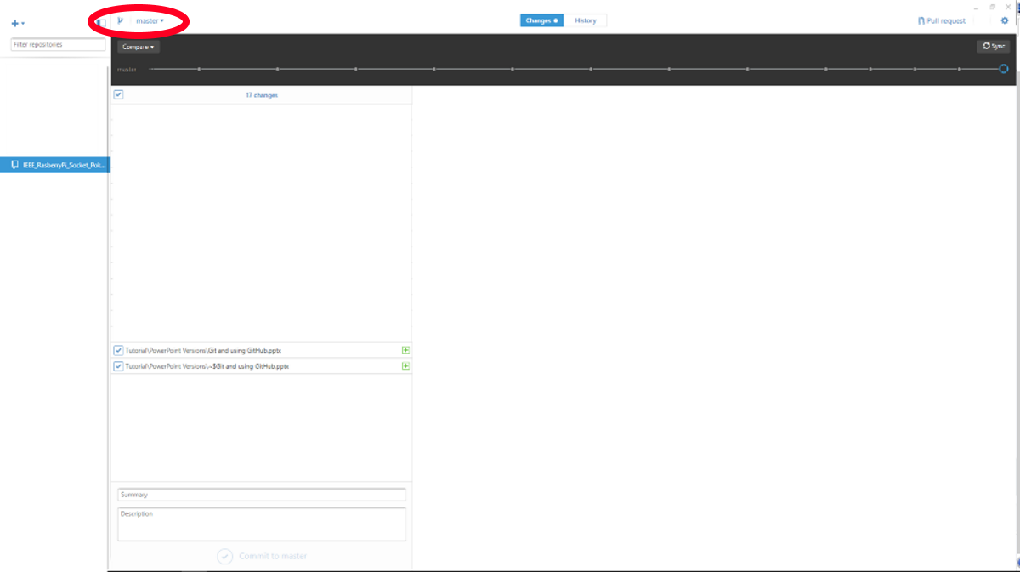
Either Add a new branch or switch between branches of the project

Slide 16
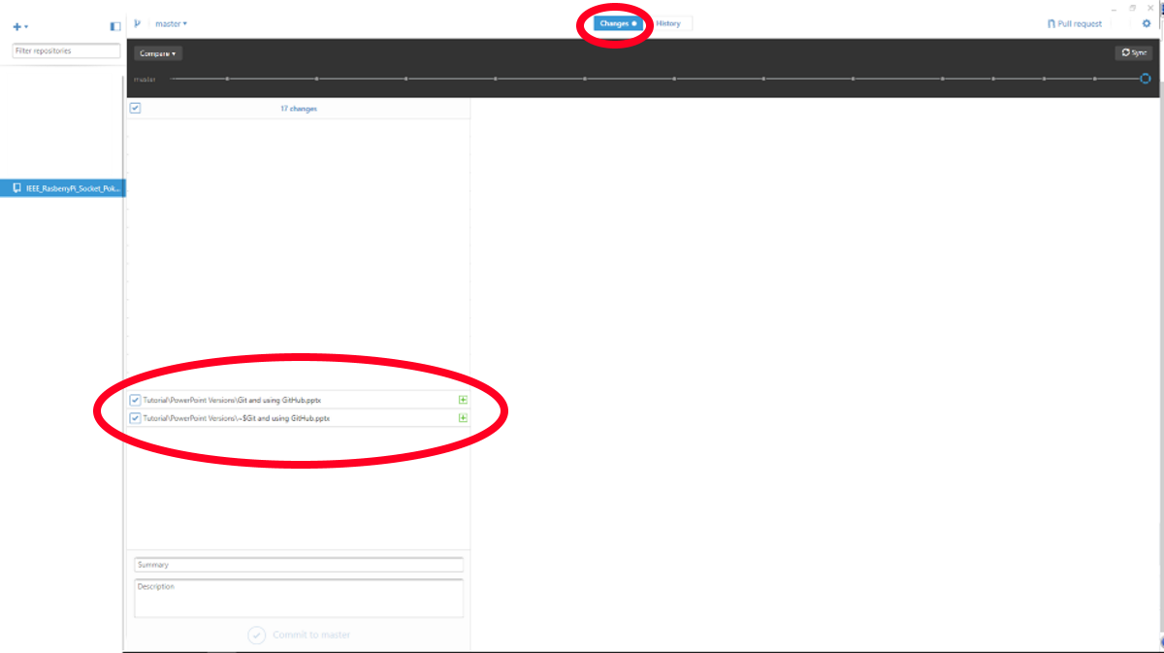
When in “Change” screen you can select which files you are Staging and want to add to the new changes

Slide 17
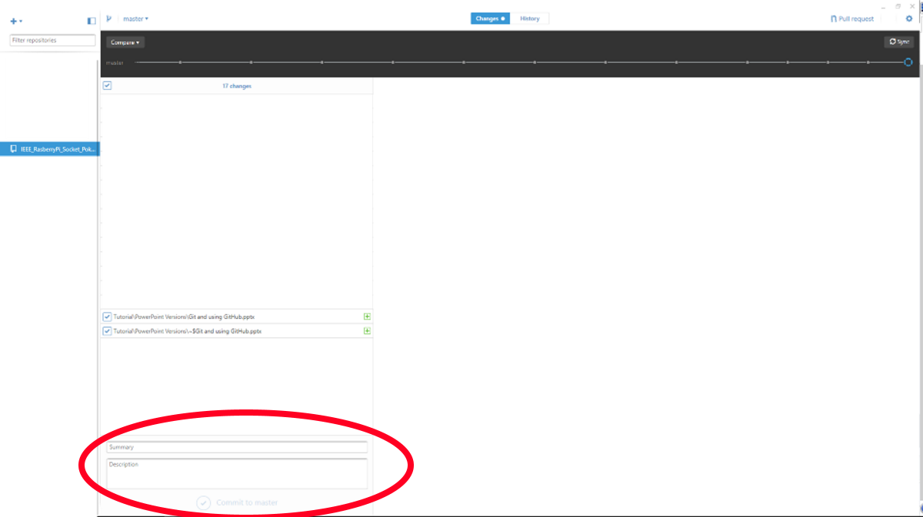
Add a Summary and Description to your Commit and Commit the changes
Remember, this is only committed on your local machine until you push the changes to the server

Slide 18
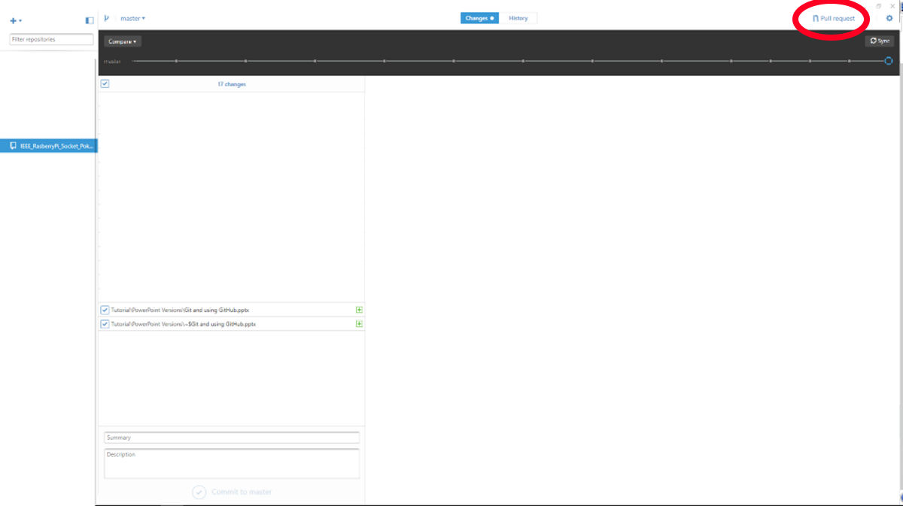
If your code is ready, you can send the Pull Request from here

Slide 19
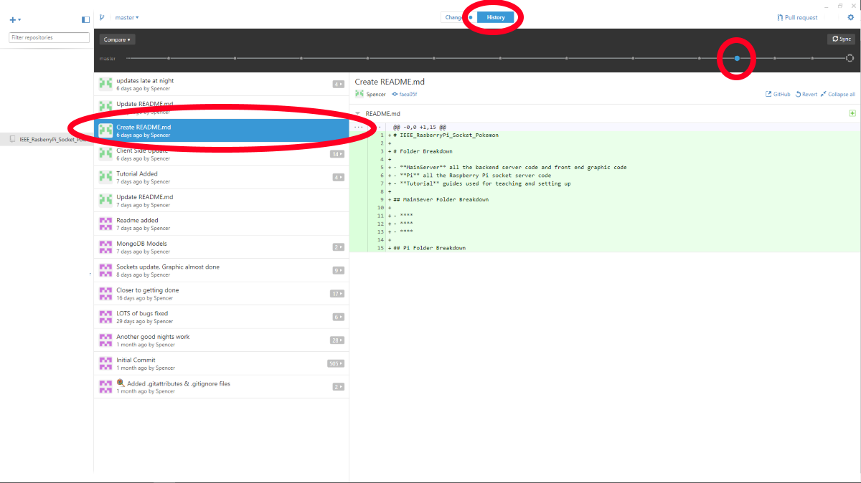
In the “History” screen you can see all the past Commits of the repository

Slide 20
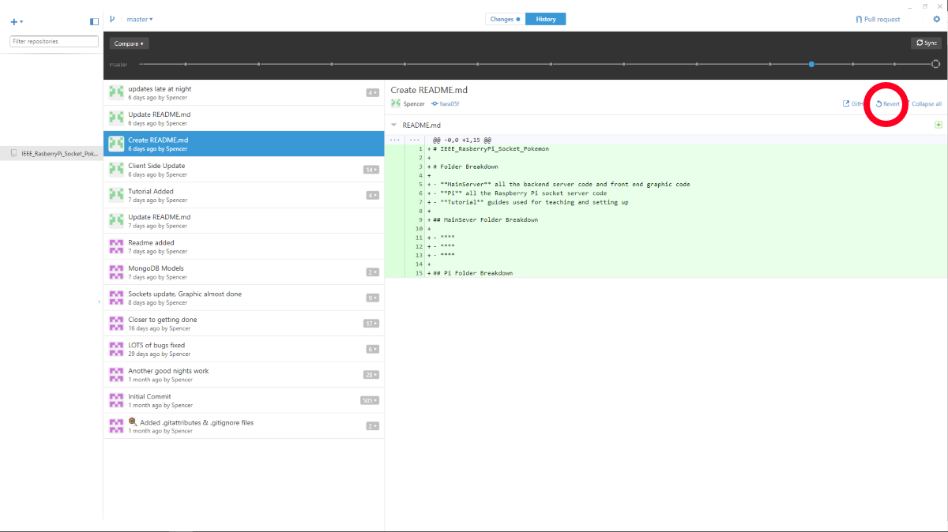
You can then Revert back to that point in the project… maybe start a new branch or see what you did or changed… this is WHY you use Version Control in the first place

Slide 21
Almost Forgot about .gitignore
Git is not the best with Binary files (.mp3, .pdf, .exe, .FileTypeICannotReadInNotepad)
When you compile projects or other things that are not made well for git, we use the .gitignore file
It list all the folders and files that git will not recognize and won’t ask you to stage them for committing
Almost all types of projects have a standard .gitignore template found on GitHub when making a new project

Slide 22
Recap
Get Repository (Clone) or Sync it (Fetch)
Know which Branch you are in
Make your changes
Set which changes you are Staging
Commit the changes
When ready, Sync or send a Pull Request
Think how awesome it is you can now work on code projects with someone else, granted they probably didn’t comment it correctly, but that’s a different slide show I am not writing

Slide 23
Best Practice
These are the best two sites to practice with
https://try.github.io/levels/1/challenges/1
http://learngitbranching.js.org/
Here is a repo you can mess with
https://github.com/sjfricke/IEEE_Practice_Git

